Slide 1

Introduction to Version Control and Git Basics

Slide 2


Today's Learning Objectives
Understanding the functioning of a Version Control System
Understanding the Git control workflow
Integrating Git into your project

Slide 3

Poll Time
Q. Which of the following is not a feature of Git?
Version control
Code collaboration
Time tracking
Branching the code

Slide 4
Poll Time
Q. Which of the following is not a feature of Git?
Version control
Code collaboration
Time tracking
Branching the code

Slide 5
Git Fundamentals

Slide 6

Challenges Faced by Developers before Git
Notes:
Source : https://gdocservices.com/wp-content/uploads/2019/09/AdobeStock_275018160.jpeg

Slide 7
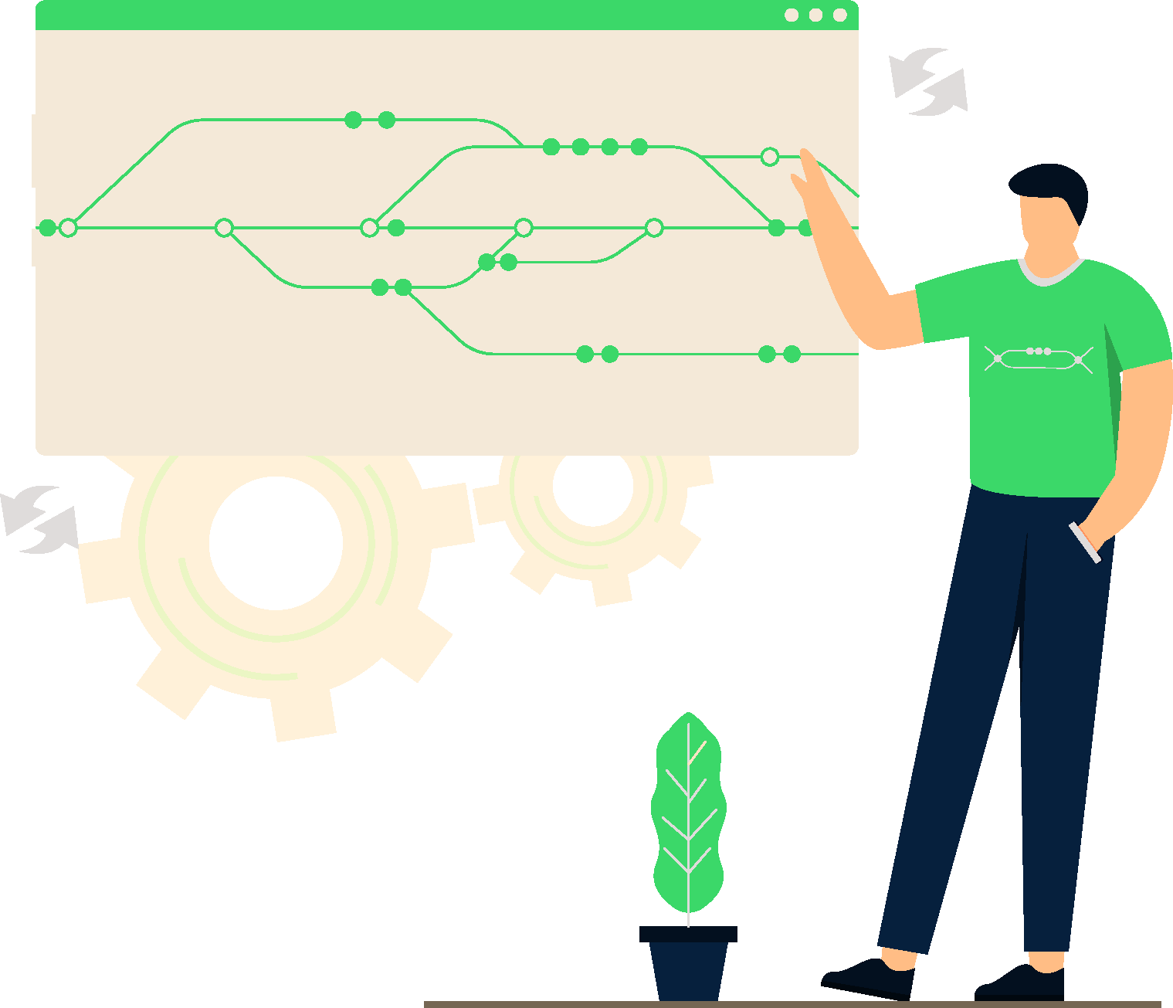
Why Git?
You have guests coming in, and you are preparing food for them. You were decorating the dessert, and you forgot that the pizza was in the oven, and unfortunately, it got burnt. Is there a way to go back now? Not really, unless you have a magic wand that can take you back in time.
The computing world can offer us a solution, and it's called Version Control System. This system helps keep track of the changes done and much more.

Slide 8
Why Git?
Backup
In case you have an accident, and you lose your memory, you just need to bring all valuable information by way of people that know you.
In their memories; your name, occupation, hobbies etc. are on record. You can download all data from there.
Note:
In all examples, it sounds a bit crazy and reveals a lot of questions but do not forget this is a metaphoric example.

Slide 9

Pop Quiz
Q. Which of the following capabilities are provided by a Version Control System?
Code collaboration
Tracking code versions
Switching between code versions
All the above

Slide 10
Pop Quiz
Q. Which of the following capabilities are provided by a Version Control System?
Code collaboration
Tracking code versions
Switching between code versions
All the above

Slide 11
How Does Git Work?
Storing Versions
Bring your best moments to light. Time with loved ones, graduation ceremony, the moment you heard that you got your dream job, etc.
Once you have a happy moment, you can just save it on VCS by giving it a message which describes its importance.
VCS also will give you a unique number that matches your message. This will be your key to going back to that peerless moment.
Ex. ‘’I’ve found my soul mate’’ could be your message and “5bw6x” could be your key to going back to that moment.
Now, you have a checkpoint. You do not have to worry about mistakes because if you face a problem in your relationship, you can go back to the beginning to fix it. It sounds pretty fun, doesn’t it?

Slide 12
How Does Git Work?
Restoring Previous Versions
You want to change your profession but not sure if you will be successful or not. You do not want it to upside down your regular life and also want to see the result.
So, tell your VCS to create a copy of your recent life. You can continue to live your main life or switch to copied one.
Anything you do in copied version of your life does not affect your main life unless you want it. So, more freedom! You may want to study medicine and start it in copied version.
If everything goes well, let it affect your main life. If you realize that you do not like to study medicine, just delete that copy and continue your life as a developer. It’s that easy.

Slide 13

How Does Git Work?
Understanding What Happened
VCS allows you to see what has changed between checkpoints. It is like giving a two picture and pointing out difference between them.
It is pretty cool, isn’t it?
You do not have to spend time to search it. Everything is obvious.

Slide 14
Pop Quiz
Q. Is it possible to pinpoint exactly which version introduced a bug in the project using a Version Control System?
Yes
No

Slide 15
Pop Quiz
Q. Is it possible to pinpoint exactly which version introduced a bug in the project using a Version Control System?
Yes
No

Slide 16
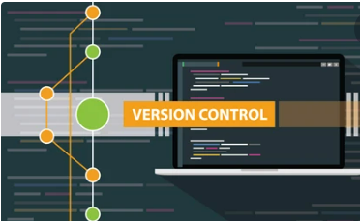
What is a Git?
It is a version control system.
It tracks changes made to any kind of file, including source code and other assets.
It enables us to revert or revoke changes done to a single file or a set of files, even after we modify them.
It can compare the changes made to files between different versions.
A mature and actively maintained open-source project.
It was created by Linus Torvalds in 2005.
It is released under GPL’s open-source license.
It is free to download and use.

Slide 17
What is a Git?
It has a distributed architecture. Anyone can request the latest version of the work from this server and, if required, push the latest changes back to the server.
It is fast and small.
It does not rely on the central server.
As most of the operations are performed locally, it gives a huge benefit in terms of speed.
Though Git mirrors the entire repository, the size of the data on the machine is relatively small.
It is designed to be secure and flexible, making it the de-facto choice for most software teams and enterprises.
It is used by all kinds of companies, be it large enterprise or startups.

Slide 18





Role of Git in Full Stack Development
Notes:
Source : 0*ztz8WmPgeN3a8kJk.jpg (1200×675) (medium.com)

Slide 19
Pop Quiz
Q. What is true about Git?
Git is open-source
Git is an example of distributed version control system
Used for handling the development of small and large projects
All the above

Slide 20
Pop Quiz
Q. What is true about Git?
Git is open-source
Git is an example of distributed version control system
Used for handling the development of small and large projects
All the above

Slide 21
Installation

Slide 22
Installation
Windows: You can install Git by downloading the installer from git-scm.org.
Linux: Most Linux distros have Git pre-installed. If not, it can be easily installed using the sudo apt install git-all command.
Mac: Most likely, your Mac has Git pre-installed. If not, you can install the Xcode Command Line Tools from the App Store.

Slide 23
Verifying Installation
Run the following command on the terminal/command prompt to verify Git:
$ git --version

Slide 24
Poll Time
Q. Which of the following systems support Git?
Windows
Mac
Linux
All the above

Slide 25
Poll Time
Q. Which of the following systems support Git?
Windows
Mac
Linux
All the above

Slide 26
Working with Git

Slide 27



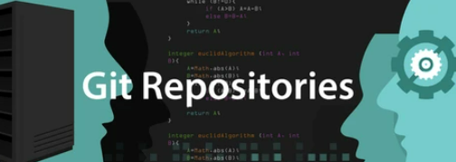




Working with Git
Developer 1
Business organization
Developer 2
Developer 3

Slide 28
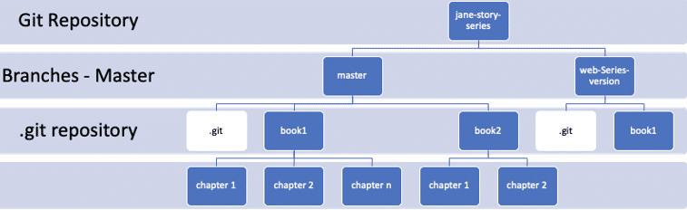
Git Repository
A Git Repository is a representation of the project hierarchy with folders and files structured under it.
Every git project starts with a .git directory.
This is the origin of the project's data, and this is where Git stores the metadata and object database for the project.
The default branch is typically referred to as “Main”.

Slide 29
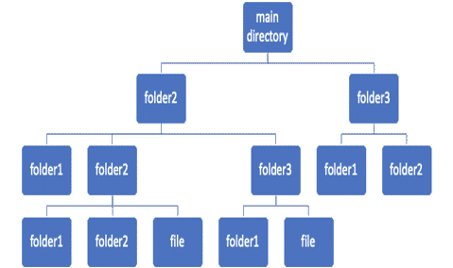
Git Working Directory
The Git working tree or Git working directory is like a workbench or a working copy of the repository.
It may contain the same content as a branch in the repository, but it can also be completely different, depending on the changes made to it.
We can modify the existing files, add new files or delete a few files present in the working tree.

Slide 30
Pop Quiz
Q. Which command is used to initialize Git in a project?
git start
git begin
git track
git init

Slide 31
Pop Quiz
Q. Which command is used to initialize Git in a project?
git start
git begin
git track
git init

Slide 32
Git Architecture
Git uses a three-tree architecture. The staging index is also referred to as the Staging Area.
When we want to move files between various folders of the working tree, we "checkout" the files into our working tree, and when we finish making our changes, we “commit” those changes back to the repository.
However, in Git, a “commit” is a two-step process. We add our files to the staging index, and then from there, we commit to the repository.
Working Directory
Staging Area
Git Repository
Git's Three Trees

Slide 33
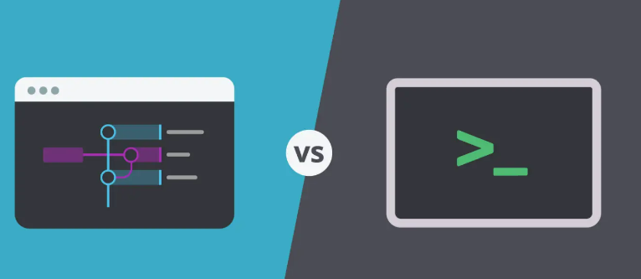
Command Line vs. Graphical User Interface
Git, like many other software tools, can be operated in two ways - via a Graphical User Interface (GUI), or through a Command-line Interface (CLI).
Git comes with built-in GUI tools like git-gui and gitk for committing and browsing.
Graphical User Interfaces (GUI) can help beginners and the most advanced users to become more effective faster.
CLI is based on giving commands through the terminal.
CLI is also the default choice when it comes to certain specific tasks like automation through scripts, SSH tunneling into remote servers, etc.

Slide 34
Git vs. GitHub
Notes:
Github is the central repository in the distributed version control system

Slide 35
Git vs. GitHub
Git
Version Control Software for developers (VCS)
Enables push and pull from another system installation
GitHub
Web-based platform with git VCS features
Good for collaborative work
Good for individual use
Provides project and team management features
Open-source
Owned by Microsoft

Slide 36
Pop Quiz
Q. The files that can be committed are always present in ____ ?
Working directory
Staging area
Backlog
Commit from anywhere, there's no barrier

Slide 37
Pop Quiz
Q. The files that can be committed are always present in ____ ?
Working directory
Staging area
Backlog
Commit from anywhere, there's no barrier

Slide 38
Activity
Think of a sentence or phrase that you want to save. For example, "I am currently learning git."
Write it down in an empty text file.
Take a screenshot.
Now, make a small change to the sentence or phrase, for example, add a word or remove a word. For example, "I am currently learning git and GitHub."
Take another screenshot.
Compare the two pictures and see the difference.
Repeat steps 4-6 as often as you like.

Slide 39
Basic Workflow

Slide 40
Steps in a Git Workflow
A Git workflow defines or recommends the steps to use various Git features effectively and consistently.
Create a repository.
Make your changes.
Add the files to the staging.
Commit the files to the repository.
Repeat steps 2 to 4.

Slide 41
Local vs. Remote Repositories
Local Repository:
A local repository has a working copy of the file associated with it, a directory where some version of your project's files is checked out for you to work with. Local repositories are physically and locally managed by individuals.
Remote Repository:
A remote repository is like the local one in terms of operations such as branch, commit, etc. They are like caching proxies managed by remote links. It is a virtual storage of the current project. Hosted on a server that is more accessible across multiple devices and to multiple users - most likely on the internet or a local network.

Slide 42
Poll Time
Q. What is a remote repository?
A version of the repository that mirrors changes made in the local repository's master branch for open-source collaboration efforts
The lead repository elected by the Git arbitrator found within local repositories of collaborating team members
A read-only version of the repository stored on a backup server in case local repositories become lost or corrupted
A version of the repository hosted on the internet or network that is pushed to or pulled from by collaborators
Notes:
Trainer: Now, its time for a quick polling. Again you will have 30 seconds pop-up on your screen to answer this.
(Post 30 seconds) Wonderful, lets see what the majority of you have answered

Slide 43
Poll Time
Q. What is a remote repository?
A version of the repository that mirrors changes made in the local repository's master branch for open-source collaboration efforts
The lead repository elected by the Git arbitrator found within local repositories of collaborating team members
A read-only version of the repository stored on a backup server in case local repositories become lost or corrupted
A version of the repository hosted on the internet or network that is pushed to or pulled from by collaborators

Slide 44
Initialize Git Repository

Slide 45
Initialize a Git Repository
The folder paths and initialization commands for Mac, Windows, and Linux are shown below:
$ git init
The init command in git opens a blank repository. It creates a .git subdirectory inside the current working directory.

Slide 46
Activity
Create an empty git repository.
Add a 'readme.md' file in it with a brief profile summary about yourself. Example: Name, location, nationality, hobbies, fav books/movies, etc.
Add another file called 'notes.md' with key learnings from past sessions (including Linux, Git, web dev intro).
Add both files to the staging area.
Make the first commit.

Slide 47
Summary
VCS allows you to rollback versions, provide better visibility into changes, act as backup for code and allow collaborative coding.
Git is a distributed VCS where there is no dependency on one single code repository.
Git uses a three-tree architecture -> Working directory, Staging Area/Index, and Git Repository.
Local repository vs. Remote repository
git init – initialize an empty git repo
git status – get the current status of the repo
git add – add files to the staging area
git commit – commit the changes

Slide 48
Thank You
Copyright © Upgrad., All rights reserved
Confidential Information, intended for approved distribution list of Upgrad

